Slide 1
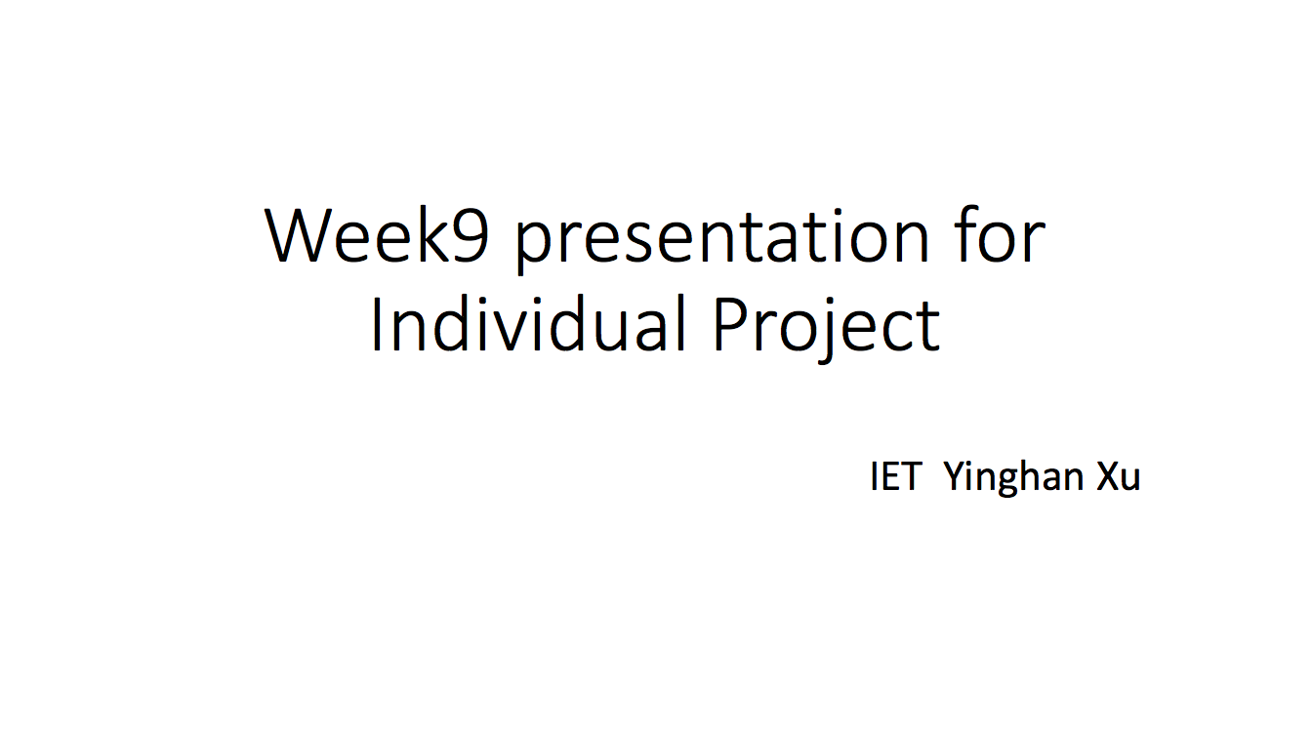
(After revising)

Slide 2
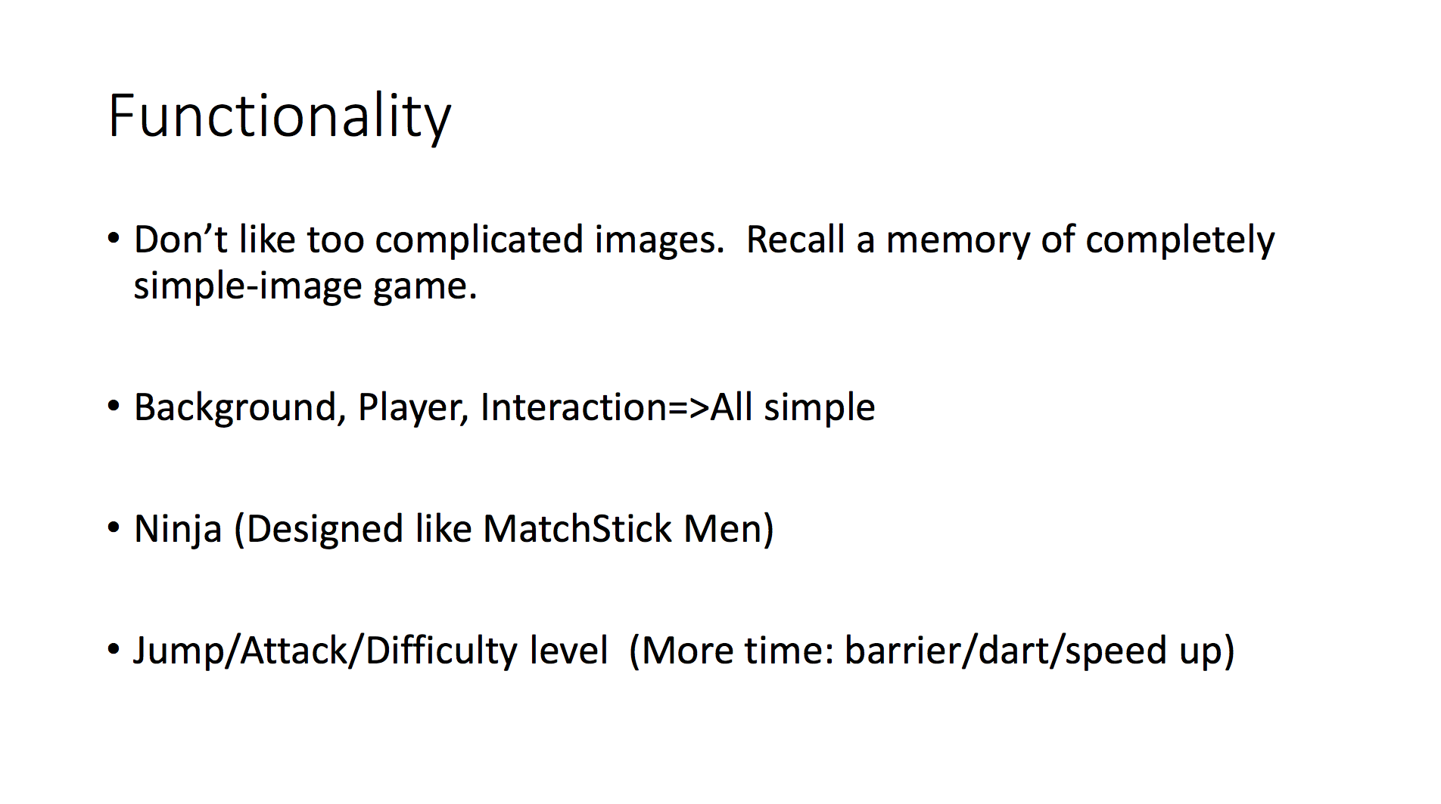

Slide 3
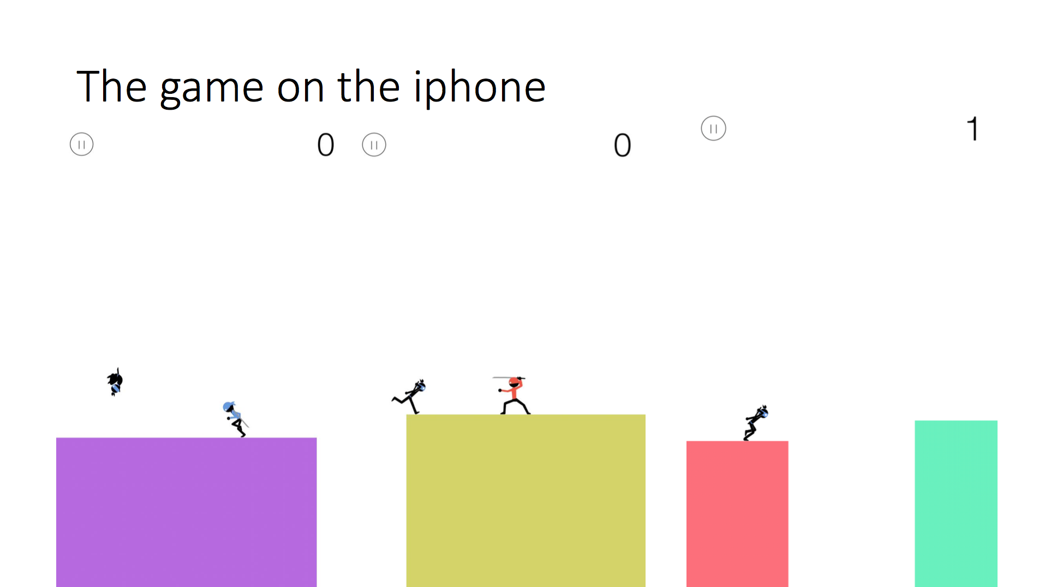

Slide 4
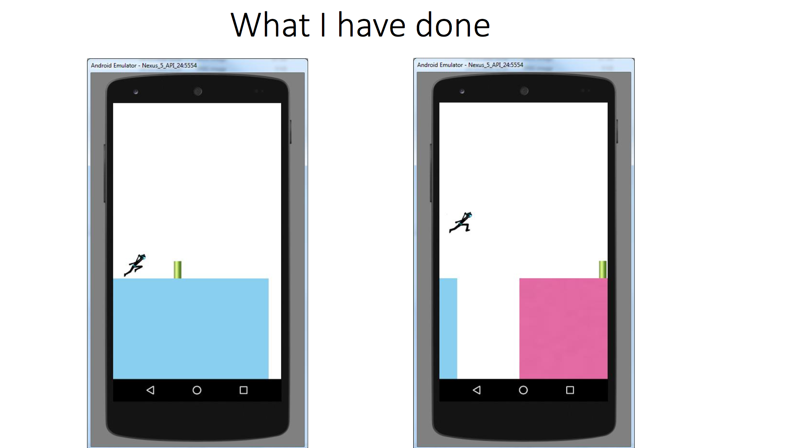

Slide 5
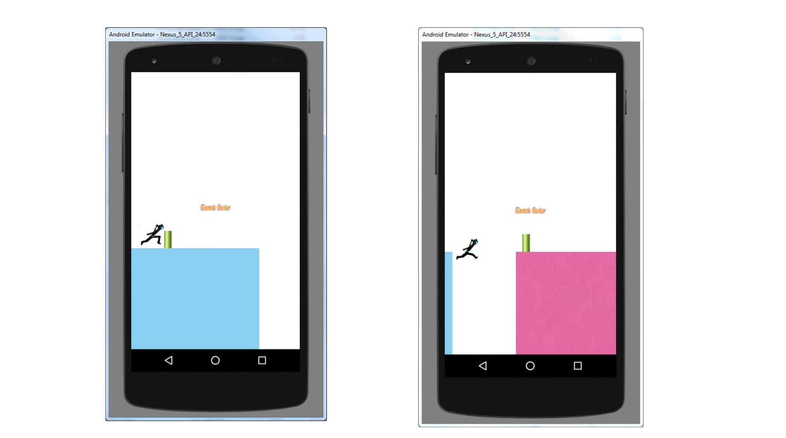

Slide 6
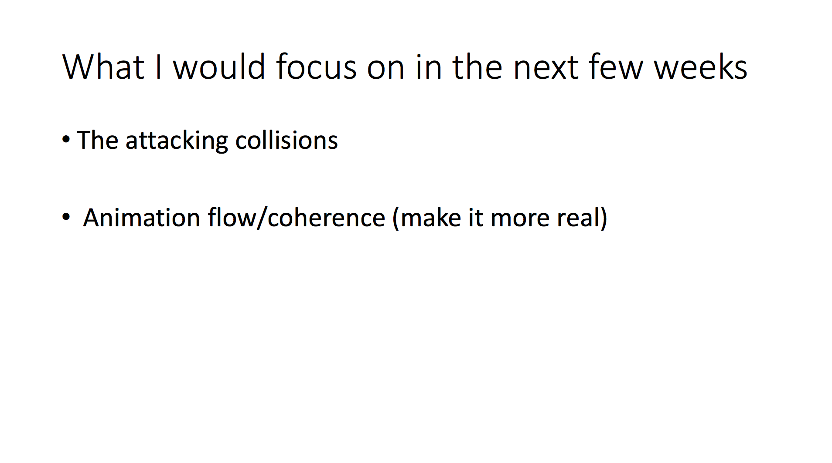

Slide 7
What I have learned and the difference I would make the next time.
I would still do the same presentation for the week 9 presentation if asked again, because that what I have done and will do in the next few weeks. However, after knowing I was a little falling behind the plan, I should give the new plan instead of just telling myself to finish the task left from the previous weeks.

Slide 8
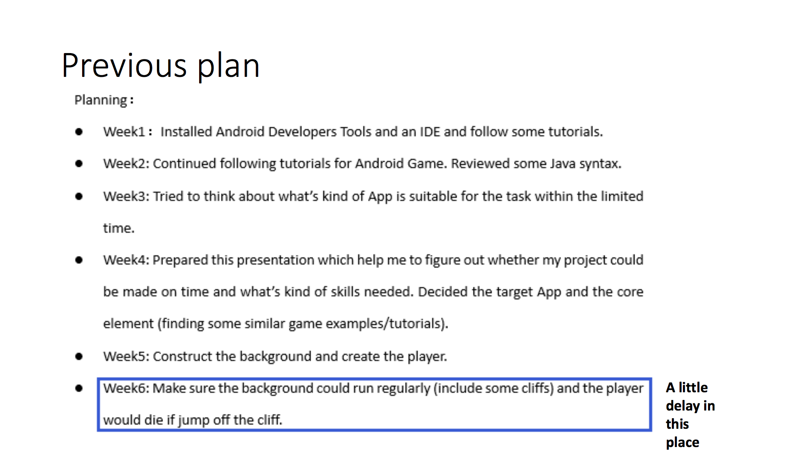

Slide 9
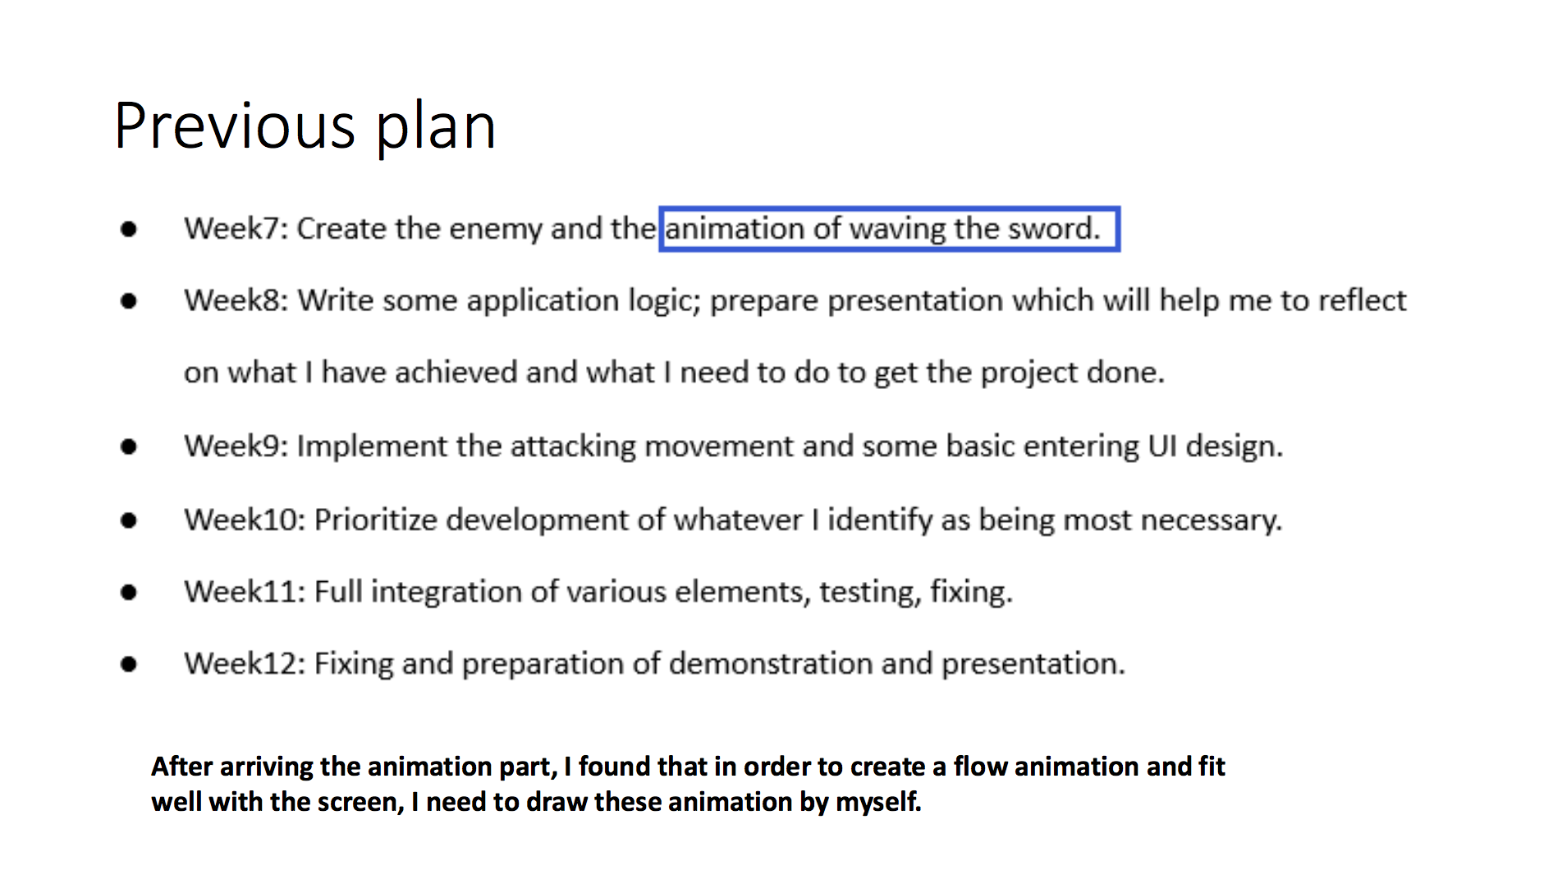

Slide 10
New plan for the next few weeks
Week 10: Deal with the logic determination of waving the sword, as I said in the week 4 presentation. So the whole system can work very nice.
Week 11: Add the score we get (without considering at the beginning of design the game) and the game initial UI background.
Week 12: Fix some little bug and prepare the week 12 presentation.

